Slide 1

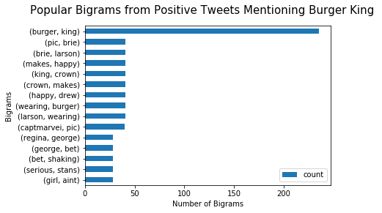
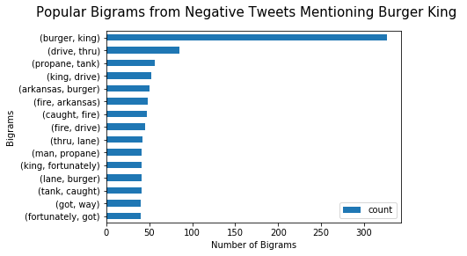
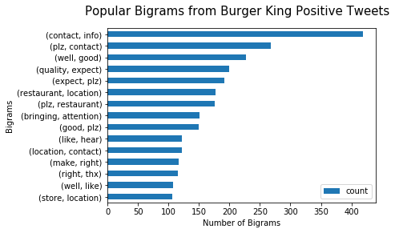
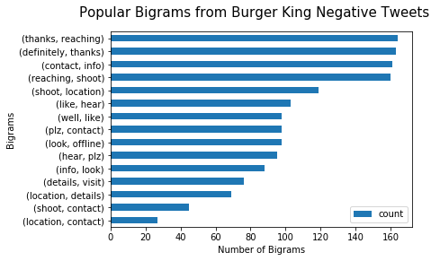
Burger King Twitter Analysis Findings / Results
Sentiment Analysis

Slide 2
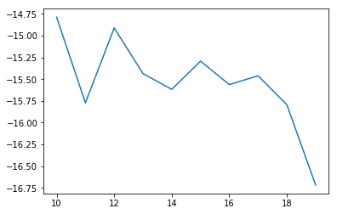
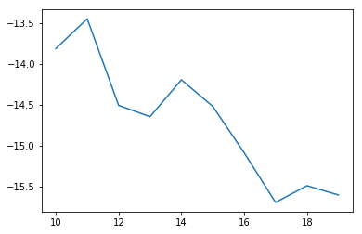
Burger King Twitter Analysis Findings / Results
Topic modeling using LDA
Determining optimal k-value
Tweets Mentioning Burger King
Burger King Tweets
Optimal k-value: 10
Optimal k-value: 11

Slide 3
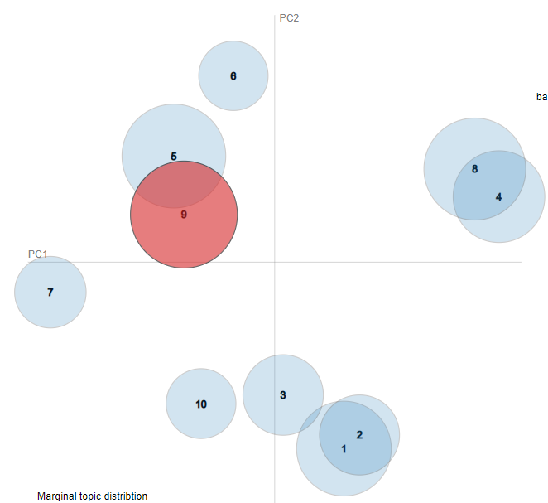
Burger King Twitter Analysis Findings / Results
Topic modeling using LDA
Tweets Mentioning Burger King Topics:
Burger King timing sucks
Burger King is like McDonald's and Wendy's today
McDonald's and Wendy's mad customers want food
Folha commercials and Arkansas fire car explodes
Burger King mentions in Portuegese community
Sunset in Bali
Brie Larson pictures or Captain Marvel wearing crown
There is fire in the drive thru
Barstoolsports posts
Burger King mentions in Italian community

Slide 4
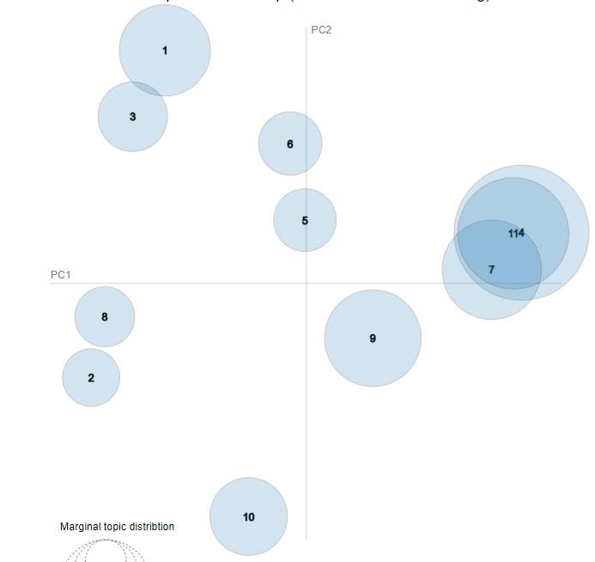
Burger King Twitter Analysis Findings / Results
Topic modeling using LDA
Burger King Tweets Topics:
Sorry to hear the situation
One day, people could see Kevin Abstract the rapper
Please contact the store location and sorry to hear what happened
Assistance needed in the Burger King store location
Burger King needs to resolve asap in this store location
Expect some quality at this location and please allow us to make it right and contact us
Love whopper and order and management team and experience
Thank you for bringing up the attention to us
Sending thanks
Please contact the information by email

Slide 5
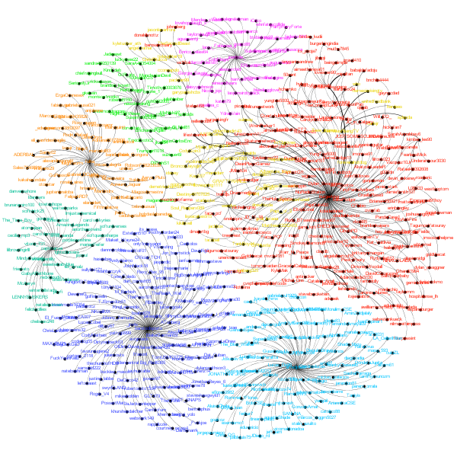
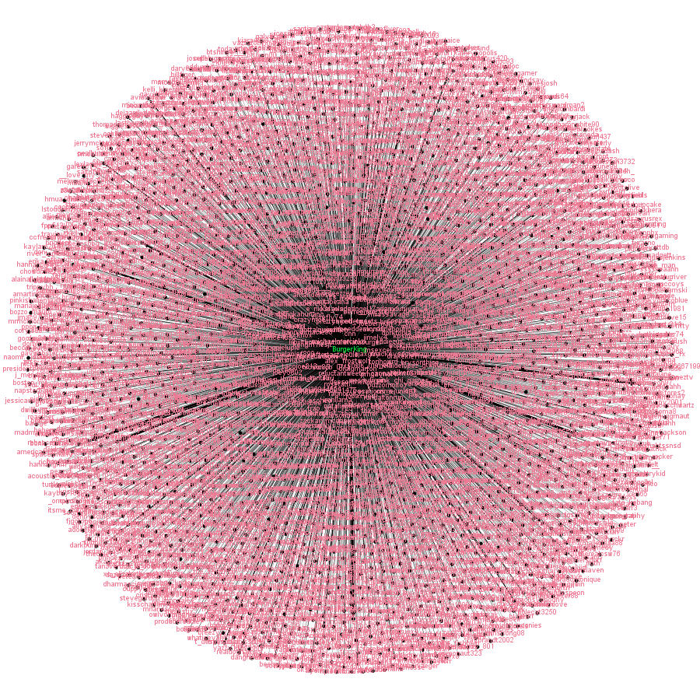
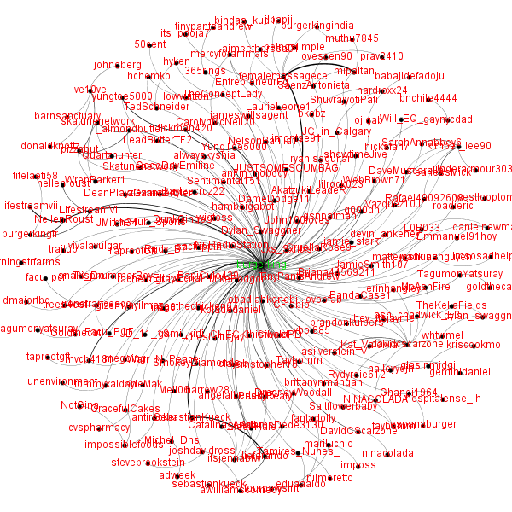
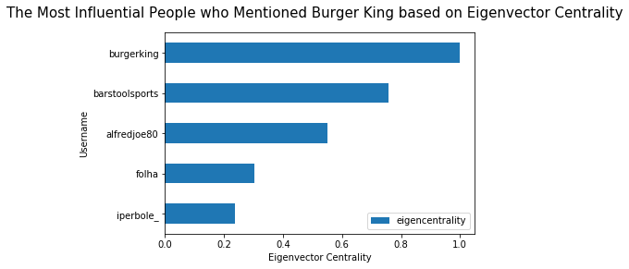
Burger King Twitter Analysis Findings / Results
Network Analysis

Slide 6
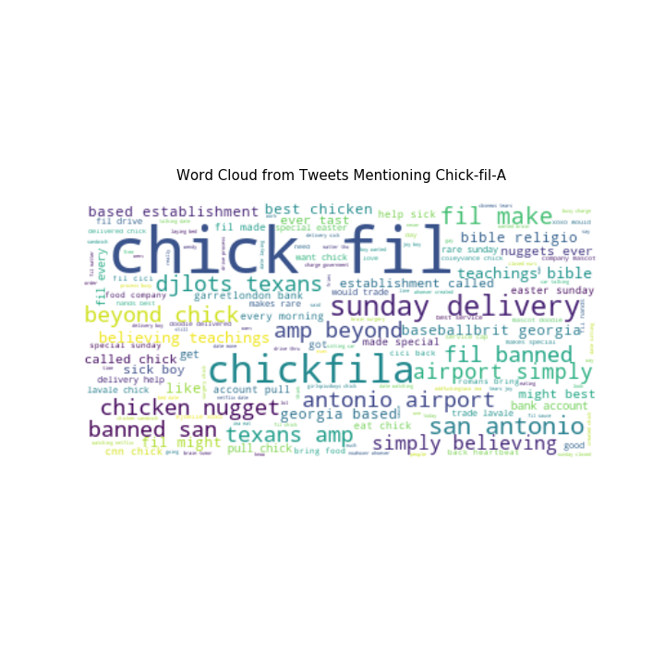
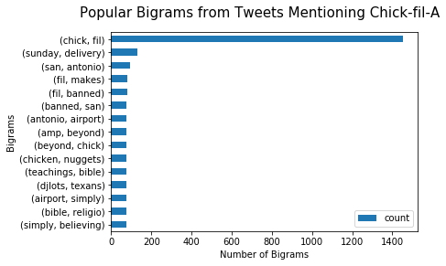
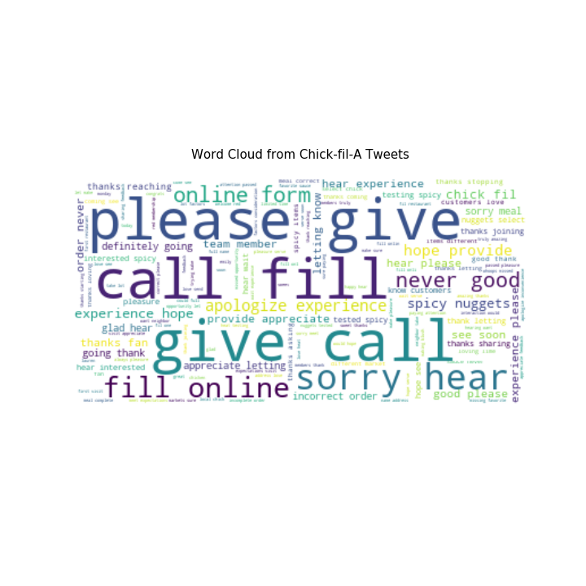
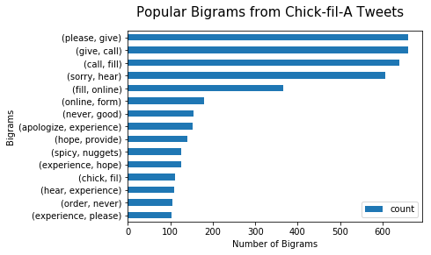
Chick-fil-A Twitter Analysis Findings / Results
Descriptive and Content Analysis

Slide 7
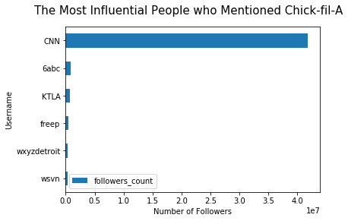
Chick-fil-A Twitter Analysis Findings / Results
Descriptive and Content Analysis
Notes:
It appears that the most influential username that mentioned Chick-fil-A was a giant news company, CNN, which tweeted about Chick-fil-A special easter Sunday delivery to help a very sick boy. CNN is a very influential Twitter user and has more than 41 million followers and fortunately, the sentiment of CNN tweet is positive, which is good for Chick-fil-A.

Slide 8
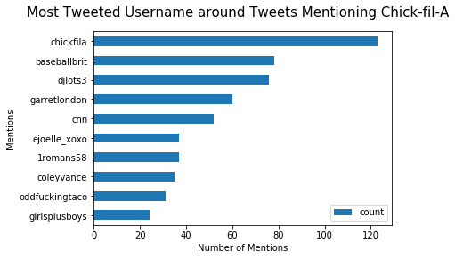
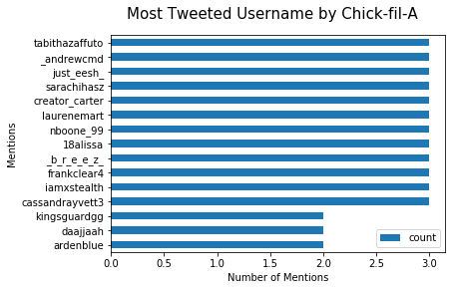
Chick-fil-A Twitter Analysis Findings / Results
Descriptive and Content Analysis
Notes:
There are 12 users that have been most mentioned by Chick-fil-A.

Slide 9
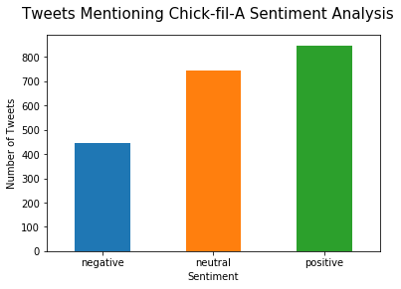
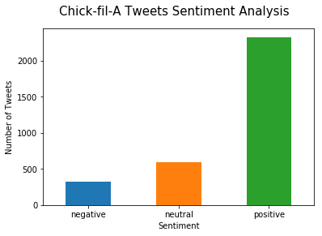
Chick-fil-A Twitter Analysis Findings / Results
Sentiment Analysis
Notes:
The average sentiment for Tweets mentioning Chick-fil-A : 0.09 negative 446 neutral 744 positive 848
The average sentiment for Chick fil a tweets: 0.36 negative 319 neutral 591 positive 2326

Slide 10
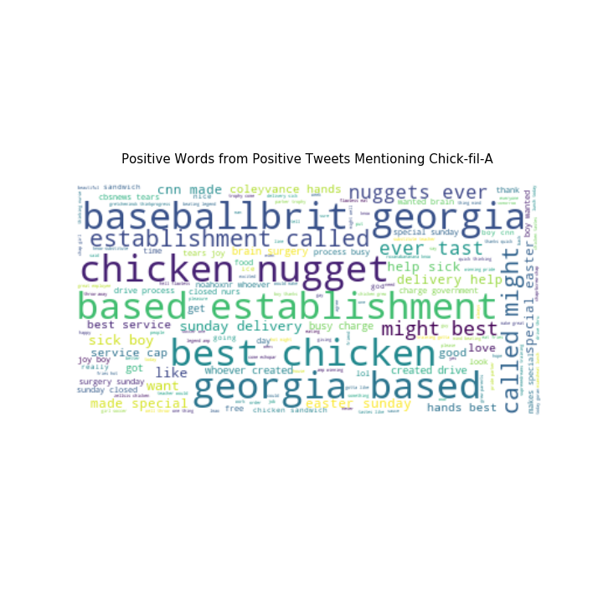
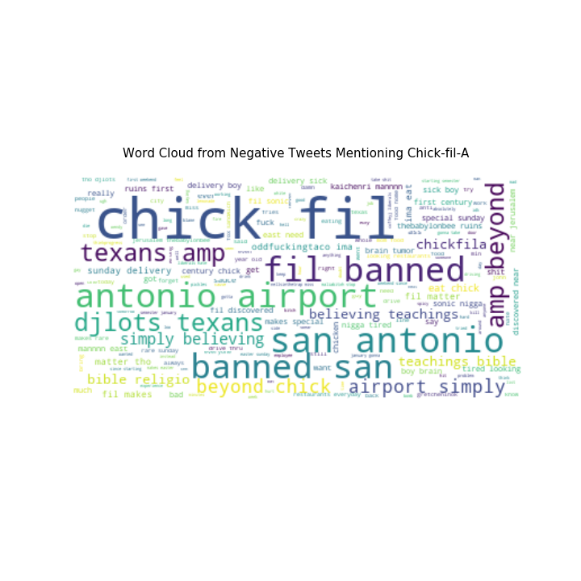
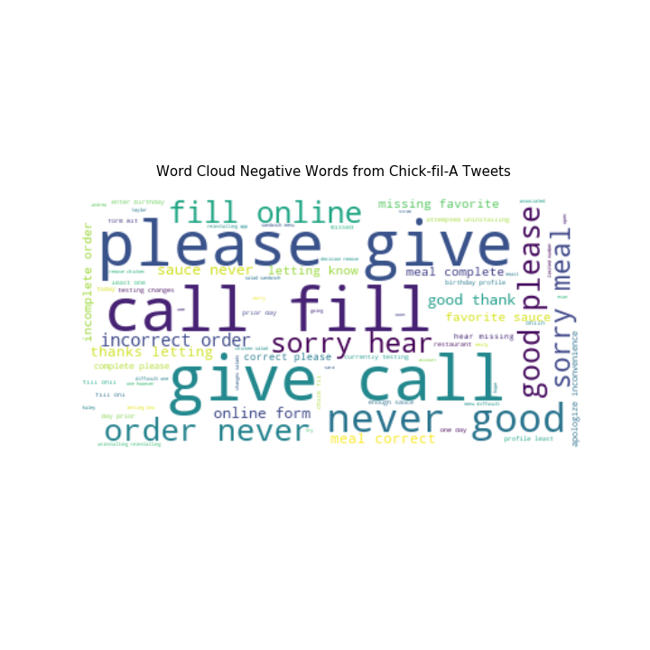
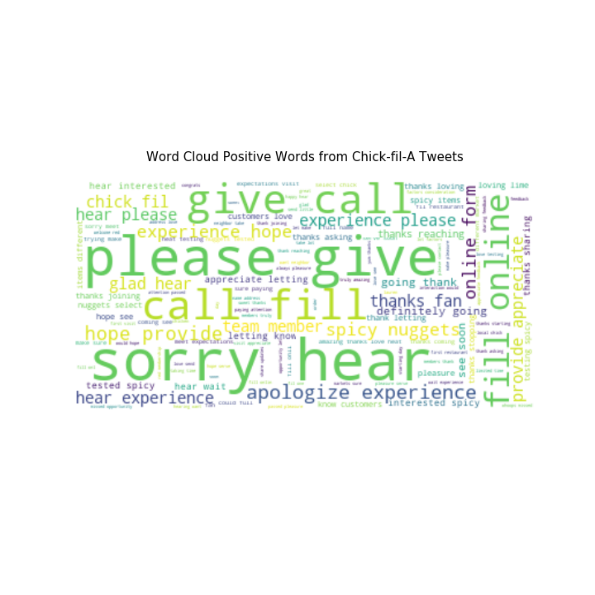
Chick-fil-A Twitter Analysis Findings / Results
Sentiment Analysis

Slide 11
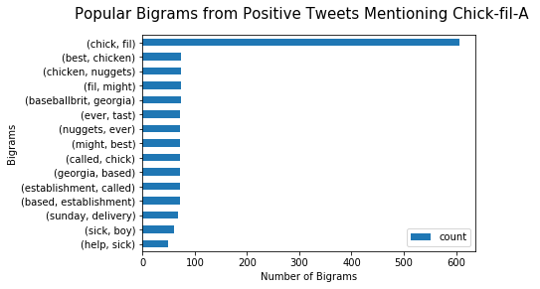
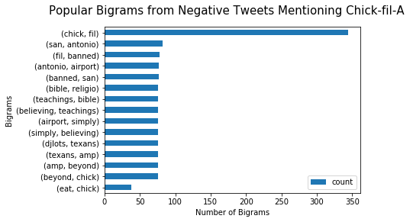
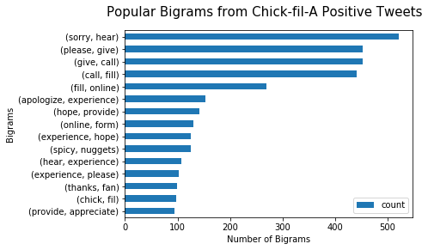
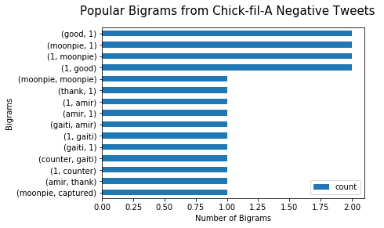
Chick-fil-A Twitter Analysis Findings / Results
Sentiment Analysis

Slide 12
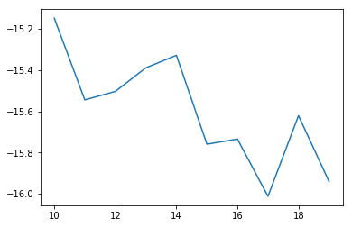
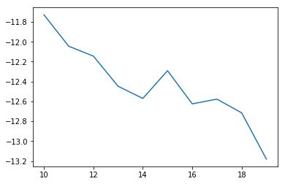
Chick-fil-A Twitter Analysis Findings / Results
Topic modeling using LDA
Determining optimal k-value
Tweets Mentioning Chick-fil-A
Chick-fil-A Tweets
Optimal k-value: 10
Optimal k-value: 10

Slide 13
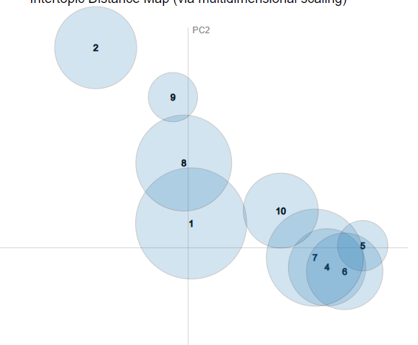
Chick-fil-A Twitter Analysis Findings / Results
Topic modeling using LDA
Tweets Mentioning Chick-fil-A Topics:
Special Sunday delivery to a very sick boy
Best chicken nugget Georgia-based
First discovered near ruin in Jerusalem
Watching and eating Chick-fil-A
Polynesian mom try Chick-fil-A sauce
A man orders Chick-fil-A
Every morning drinks at Chick-fil-A
San Antonio airport banned bible
Best service and best sauce and milkshake
Drive fry Chick-fil-A

Slide 14
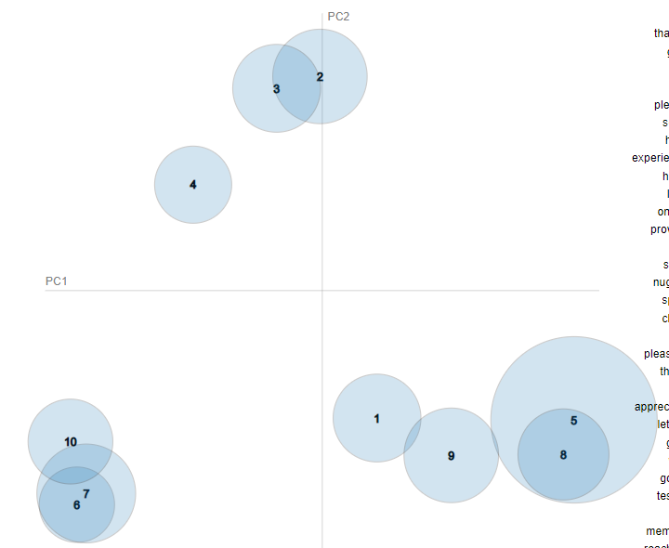
Chick-fil-A Twitter Analysis Findings / Results
Topic modeling using LDA
Chick-fil-A Tweets Topics:
Appreciating customers visits
Spicy nuggets seem interesting
Love testing new spicy item that could be different
Chick-fil-A is always reaching local and great
Apologizing to customers and directing them to contact by call
Membership app
Thanking fan, member, server, and team
Hearing customer's voice by appreciating and apologizing for mistakes
Appreciating customer's feedback and make up for them
Appreciating for feedbacks and sharing chicken

Slide 15
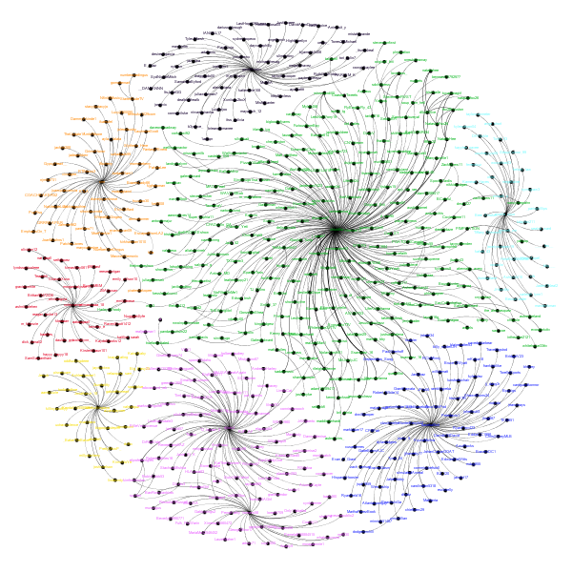

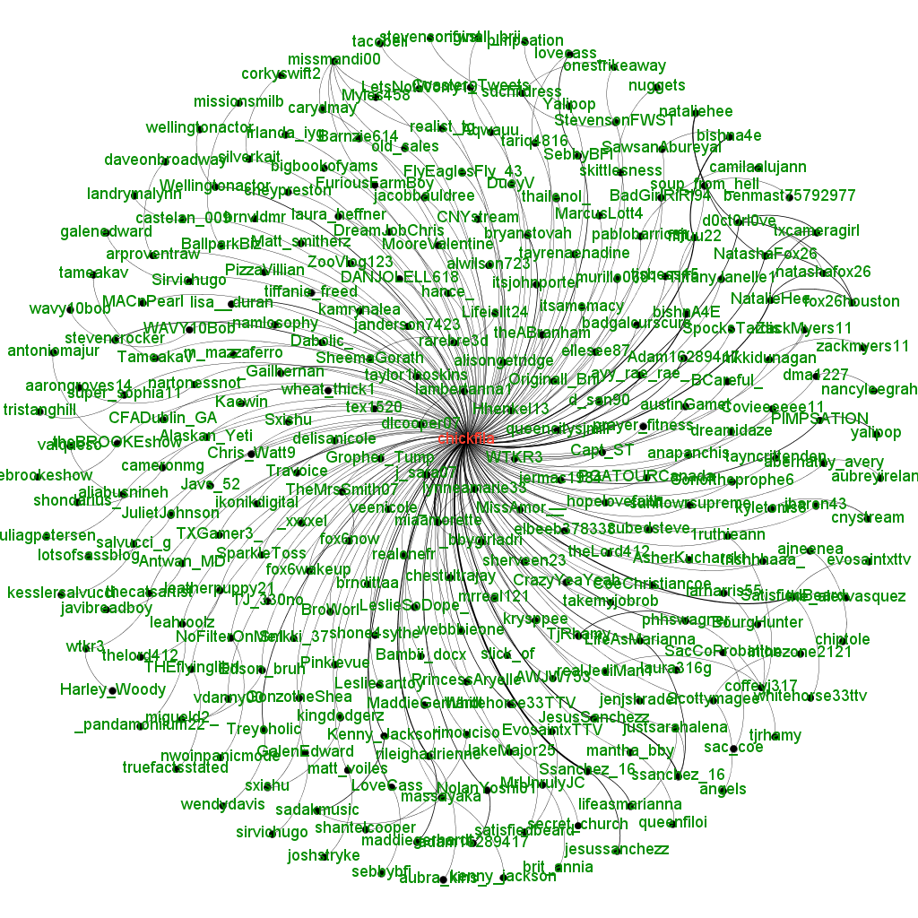
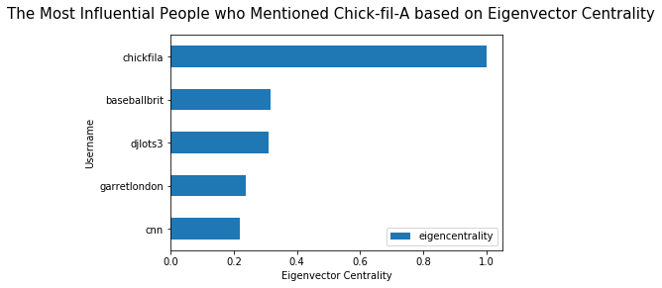
Chick-fil-A Twitter Analysis Findings / Results
Network Analysis

Slide 16
Conclusion/Summary/Storytelling
From more or less than 3000 tweets, each company barely does promotion in their tweets. Mostly, they just respond to customer’s feedbacks and directs them to their hotline number or email. However, only McDonald’s did some kind of sweepstakes and they responded to their customer’s entry in Twitter.
People like to talk about the French fries of McDonald’s, the video of an explosion of a truck on Burger King’s drive thru, and Chick-fil-A’s Sunday delivery to a sick boy.
Chick-fil-A has the most positive tweets from people’s tweets and the company’s own tweets. McDonald’s and Burger King mostly have neutral sentiment on their tweets and from people’s tweets.
The most influential people who mentioned these 3 companies are all media organizations. These organizations have the most followers among all people who mentioned these companies. News and media company mentioned Chick-fil-A and Burger King while a travel magazine company mentioned McDonald’s.
For Burger King, there are so many Brazilian people who mentioned and talked about Burger King. Perhaps, it was also mentioned by the most influential person, Folha which is a newspaper company based in Sao Paulo.

Slide 17
Conclusion/Summary/Storytelling
For positive reviews, many people love Chick-fil-A’s chicken nuggets. Many people also talked about Captain Marvel and Brie Larson mentioning Burger King. As for McDonald’s, people like about the company’s arches.
For negative reviews, many people talked about Warren Buffet’s plans leaving McDonald’s. Many people also talked about a truck exploding on Burger King’s drive thru in Arkansas. People also mentioned San Antonio airport banning Chick-fil-A.
It is interesting sometimes to see how people talked a lot about weird things related to each company. But, it is also good to know what is going on Twitter and what people are talking about.
Sometimes, it is also helpful to see what irritates people or what makes people like things from each company.
For network analysis, the tweets mentioning each company are divided into 8 clusters using Gephi. All 3 companies have 8 different clusters, where the biggest cluster is centered on each company.

Slide 18
Sources
https://news.mcdonalds.com/press/multimedia-library/logos
https://commons.wikimedia.org/wiki/File:Burger_King_Logo.svg
https://en.wikipedia.org/wiki/File:Chick-fil-A_Logo.svg

